Slide 1

Cinepolis: Data Science Learning Session #2
Databases, Database Design, and Menu Exploration Deep Dive
9/12/2018

Slide 2
Agenda
Quick review of learning session purpose and agenda
Progress update
Discussion about databases, database design, and Entity-Relationship-Diagrams
Technical walkthrough
1
2
3
4

Slide 3
Curriculum and schedule

Slide 4
Our objectives for the bi-weekly learning session
Share our expertise
Provide a progress update
Identify key challenges
Technical deep dive/roadmaps
Collaborate and share our knowledge on modeling topics and best-in-class solutions
High level update the team on steps taken over the last two weeks and key technical developments
Discuss key challenges we have faced and steps taken to overcome those challenges
Code walk-through and process discussion of how the models are developed, refined, and deployed

Slide 5
Over the next three months we will cover a variety of topics in addition to status updates and code reviews
Aug. 23rd
Sept. 12th
Oct. 3th
Oct. 22nd
Nov. 1st
Nov. 7th
Introduction
Data Preparation
Modeling and Production
Overview
Data Science overview and key topics
Sandbox creation and ERDs¹
Experiment design and data engineering
Identifying candidate models and testing
Validation and selection of models
Creating production systems for models
Deep dive
Frequency challenge clustering
Menu exploration rules/propensity
Movie affinity
Menu exploration CF² model
TBD
Advanced Topic
TBD
Advanced Topic
Entity-Relationship Diagram – a description of how objects are related to each other in a database and how that information can be mined for insight
CF – Collaborative Filtering

Slide 6
Many steps have to be taken before a value-adding model can be constructed and implemented
Enabling sustainable value creation
Generating and capturing value
Data exploration
Feature development
Model candidate identification
Scaling and execution
Identify what data exists
Develop new understandings
Define the problem's solution
Scale the output and execute
Explore if the question can be answered with the current data
Identify which data is usable and of appropriate quality
Combine the data create new metrics e.g. average purchases last three months, favorite product, most frequently visited location
Determine if there's an appropriate model to predict a given outcome – for example, if a customer will purchase a given class of product
Transform the entirety of the prior work into a sustainable system that can be sustained with limited updates
Our focus for today
Typical process time is 3 to 6 months for new use cases and is highly iterative

Slide 7
Progress update

Slide 8
Our next major iteration will be an update to the menu exploration – adding new intelligence to assignments
Today's discussion topic
Frequency challenge
Menu exploration
Flash Offers
Description
Hypothesis
Unlock a reward after a personalized # of visits during a specific period of time
Using game dynamics to deliver promotions based on individual frequency levels we can increase the customer frequency
Unlock a reward after purchasing a personalized set of concession products
Using game dynamics to deliver promotions based on individual consumption patterns we can increase basket size of up-sell
Offer a special discount for box office tickets during a short period of time
Delivering short fused offers promoting movies tailored to client preferences can drive an additional impulse visit

Slide 9
Since our first launch, we're taking steps to increase the effectiveness of the menu exploration use case
First iteration Business rules drove assignment of products
Second iteration Customer clusters and association rules drive products
Easy to understand and implement
'Go-to' products decided in a counted way – e.g. total numbers purchased ever
'Occasional' and 'Never' products defined as a percentage of overall purchases
Some challenges with getting these rules correct – what exactly does buy a product on one occasion but not on another mean?
Customers clustered based on purchasing behaviors to develop more targeted offers
Customers then seeded with 'go-to' products based on purchasing behaviors
Once seeded, customers then receive a tailored stretch offer based on their cluster and purchasing behavior

Slide 10
With our new association rules approach, we now have established probabilities for additional item purchases
Demographic data informs how we understand our customers…
…which inform association rules based on the seeded products
Eight clusters with unique purchasing patterns have been identified
Most frequently purchased items
Higher related products will be more likely to recommended
Those with fewer purchases will receive a more popular product
Three key questions that impact assignment
How to 'seed' the original 'Go-To' products?
What is the right level of algorithm to use for different purchase behaviors?
How to segment the customer base to maximize test value?

Slide 11
Databases – A primer

Slide 12




Financial data drove the development of early databases, new databases can scale nearly infinitely
1950's – 1960's
Early Experiments
1970's – 1990's
Relational Era
1990's – 2010's
Graph and NoSQL Era
2010's +
Big Data/Cloud Era
Early tests of how to design, implement, use databases, development of core key concepts
Limited access to large scale storage so minimal adoption at scale
Laboratories and research institutions
Widespread adoption due to increased storage availability
Relational databases allow for easy understanding of datasets and are easy to implement into business
Financial institutions and manufacturing
Development of new types of databases for different use cases, especially Graph and NoSQL databases
Expansion to be able to manage new types of use cases and data types
Capability to handle ever expanding datasets – making data and analytics of analysis and modeling
Coupled with the growth in device data, critical for large scale analysis

Slide 13
All databases share common characteristics and help us organize and analyze large amounts of data
Persistence
Consistent
Standard database features
Indexable
Structured
Shared
Distributed
Data is kept on a hard disk and not deleted
Type of data is uniform across fields and
Data can be looked up in a consistent way
There exists a hierarchy for the data in tables and schemas
Access is shared and controlled among many people
Data is distributed and backed-up on disks
Principle
Operations
Atomicity – Each statement must succeed or fail
Consistency – All actions must adhere to rules
Isolation – Transactions must be independent
Durability – Once committed, changes stay
Create – Create a new record
Read – Read an existing record or records
Update – Update a record based on new info
Delete – Delete a record with some criteria
A.C.I.D.
C.R.U.D.

Slide 14
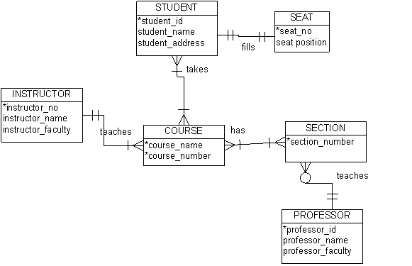
Relational databases are formed around the idea of an Entity-Relationship model
In an entity-relationship model, each item is defined in relation to another item
For example – let's define transaction records for loyalty customers from which we can define a relational database:
Each table collects data of relevant entities
Tables have defined relations between one another
Instructors are unique per person
However, many courses exist per instructor
The result is a normalized database – a database where redundant data is eliminated and data dependencies are logically sensible.
Source: University of Regina

Slide 15
There are always decisions and trade-offs in selecting and designing databases – a few common ones are:
Scalability versus complexity
Common or new database system
Fault-tolerance and support needs
Technical debt and transition costs
Databases can scale up or out – meaning a larger computers or more of them
However, the more computers you add the more likely difficult errors occur and the harder to troubleshoot
Leveraging SQL databases make them widely accessible to most IT professionals, however, a more specialized system may be able to better address the desired use case
Certain databases give near 100% certainty that transactions will be committed with fault tolerance, while others have commercial support contracts available
A new solution can help eliminate technical debt, but implies high transition costs to reach the capability of the prior system
This can increase the expenses of moving to a new database

Slide 16
Technical walkthrough

Slide 17
Progress update Propensity model development with association rules is completed
Menu Exploration
Current focus
Cluster customers into latent groups
Learn product association propensities
Seed recommendations based on customer
Apply business rules to recs
Finalize offers to customers
Improve personalization for item recommendations by grouping together similar customers
Purchasing data is very sparse
Clustering reduces sparsity
Clustering on customer demographics is insignificant
Cluster only using item purchasing behavior
Optimal number of clusters is 8
Learn a unique set of association rules for each cluster at the product subcategory level
Most single items are strongly associated with "Coca-Cola"
Most combos are associated with other food items
Optimal seed might be 2+ items per customer
Seed each customer's recommendation with average # of items per visit
Seeding methodology will determine the experimental design and business rules
Remove and replace incompatible recommendations based on business rules
What are the business rules to implement?
How do recs look after business rule pruning?
Prep offer assignments for loading into Selligent and
conduct final QA on recommendations
Do offer assignments and experimental design make sense to the business and customer?
Details
Insights & Questions
Decisions

Slide 18
Example How we assign most likely incremental product informed by average basket size and model rules
Menu Exploration
Recommendation engine
Seeding Method | Basket Size | Pros | Cons
Item_{1st} ==> MAP₁ | 2 | Low difficulty | Not incremental* Less personalized
Item_{1st} ==> MAP₁ + block most popular subcategories from being used as seed in some test cells | 2 | Low difficulty Enforces exploration Potentially incremental
(Item_{1st}, Item_{2nd}) ==> MAP₁ | 3 | Incremental | Assumes top 2 most bought products are associated Rules are more sparse for item pairs
ItemPair_{1st} ==> MAP₁ | 3 | Incremental Ensures products are associated | Rules are more sparse for item pairs
ItemTriplet_{1st} ==> MAP₁ | 4 | Incremental Ensures products are associated | Rules are even more sparse for item triplets
1a
1b
2
3
4
(Seed ==> Recommendation)
Item_{nth} = nth most bought product by customer (of baskets > 2)
MAP = Most Associated Product
* For customers with average basket size > 1
Key focus topics

Slide 19
Association rules developed over 8 unique customer segmentations
Menu Exploration
Recommendation engine
Cluster | # unique transactions | # unique customers | % of total customers | Avg. Age | % female | Avg. Tenure | Avg. # tickets per visit | Avg. # of visits per month | Avg. # of items per visit
0 1 2 3 4 5 6 7 | 11,671,316 1,791,444 203,309 508,052 188,507 8,773,526 960,710 686,476 | 2,720,161 95,664 12,673 32,730 10,317 538,848 68,805 40,335 | 77% 3% 0% 1% 0% 15% 2% 1% | 33 36 35 34 34 34 36 32 | 47% 45% 51% 49% 42% 46% 48% 48% | 30 50 45 44 50 44 42 44 | 3 3 3 3 3 3 3 3 | 2 5 5 4 5 5 4 5 | 4 5 4 4 4 4 4 4
Top 5 Items¹ by Avg. Cluster Propensity |  | 0 |  | 1 |  | 2 |  | 3 |  | 4 |  | 5 |  | 6 |  | 7
1st |  | Maxi Combo Nachos | 7% | Boneless Wings | 36% | Crepa Salada 1 Ingr | 100% | Tequesitos Philadelphia | 100% | Combo Bagui Chorizo Esp | 100% | Maxi Combo Mix | 19% | Almendras, Pasas o Arán | 54% | Plato Snack Twister | 89%
2nd |  | Maxi Combo Mix | 7% | Cerveza Nacional | 34% | Crepa Dulce 1 Ingr | 24% | Tequesitos Manchego | 25% | Bagui Chorizo Esp | 21% | Palomitas Cheddar | 18% | Panditas | 52% | Tequesitos Manchego | 23%
3rd |  | Combo ICEE | 6% | Maki | 32% | Frappe Capuccino | 23% | Frappe Capuccino | 18% | Papas Twister | 19% | Dulce de chocolate | 16% | Gomitas de Granel | 25% | Frappe Capuccino | 21%
4th |  | Palomitas Caramelo | 5% | Yakimeshi | 32% | Capuccino | 17% | Capuccino | 15% | Frappe Capuccino | 18% | Palomitas Caramelo | 16% | Frutas Ench. de Granel | 17% | Papas Twister | 20%
5th |  | Palomitas Cheddar | 4% | Quesadilla | 26% | Frappe Moka | 13% | Papas Twister | 14% | Maxi Combo Mix | 16% | Frappe Capuccino | 16% | Dulce de chocolate | 17% | Plato Snack Diperas | 18%
1. Items = Subcategories; Top 5 Items with most frequently occurring subcategories (i.e. "stop words") removed (e.g. Coca Cola, Palomitas Mix, Nachos, Palomitas Mantequilla, Combo Nachos Individual)

Slide 20
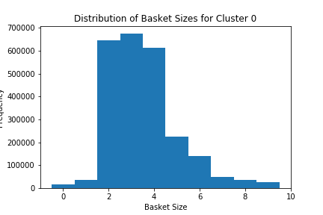
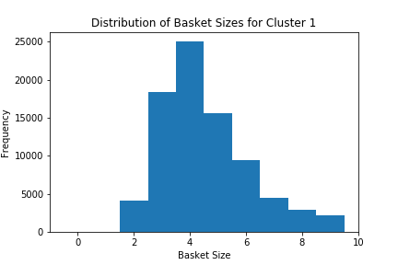
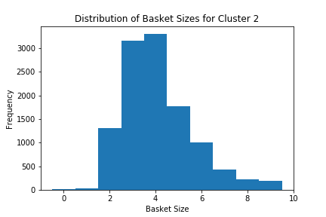
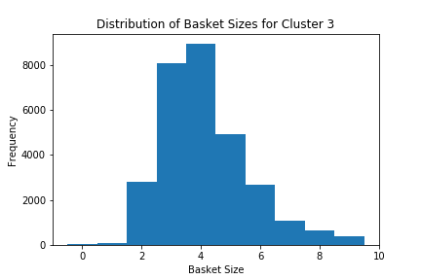
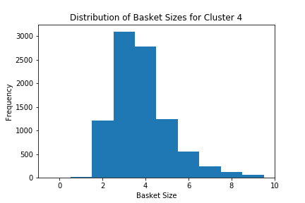
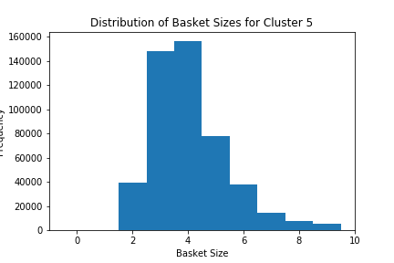
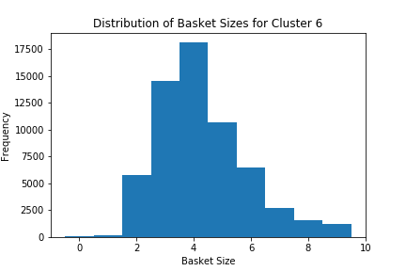
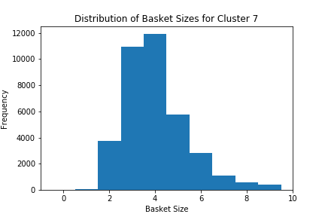
Deep-dive into "average # of items per visit" for each cluster
Menu Exploration
Recommendation engine
Frequency
Basket Size

Slide 21
Some interesting results so far around combo recommendations
Menu Exploration
Recommendation engine
Cluster 0
Cluster 4
Seed | Recommendation | Seed | Recommendation
Combo Bagui Chorizo Español | Crepa Dulce 2 Ingr | Combo ICEE | Nachos
Combo Bagui Clásico | Crepa Dulce 2 Ingr | Combo Kid | Combo Cuates
Combo Bagui Club | Crepa Dulce 2 Ingr | Combo Lunes | Palomitas Mix
Combo Bagui Español | Crepa Dulce 2 Ingr | Combo M&M | Ciel Natural
Combo Bagui Italiano | Crepa Dulce 2 Ingr | Combo Micha | Palomitas Mix
Combo Bagui Milan | Crepa Dulce 2 Ingr | Combo Nachos en Pareja | Palomitas Mix
Combo Bagui Pareja | Crepa Dulce 2 Ingr | Combo Nachos Individual | Icee
Combo Bagui Pavo | Crepa Dulce 2 Ingr | Combo Pizza | Boneless Wings
Combo Bagui Tres Quesos | Crepa Dulce 2 Ingr | Combo Plato Snack Boneless | Cerveza Nacional
Combo Baguis Chicken Crunch | Crepa Dulce 2 Ingr | Combo Plato Snack Ribs | Cerveza Nacional
Combo Burger | Coca Cola | Combo Slider | Cerveza Nacional
Combo Churro | Crepa Dulce 2 Ingr | Combo Snickers | Combo Kid
Combo Ciel | Hot Dog | Combo Sushi | Yakimeshi
Combo Clásico | Hot Dog | Combo Tostilocos | Icee
Combo Cornetto | Icee
Combo Crepa | Frappe de Chocolate
Combo Crunch | Ciel Natural
Combo Cuates | Nachos
Combo Hershey | Ciel Natural
Seed | Recommendation | Seed | Recommendation
Combo Bagui Chorizo Español | Crepa Dulce 2 Ingr | Combo ICEE | Palomitas Mix
Combo Bagui Clásico | Combo Bagui Chorizo Esp | Combo Kid | Nachos
Combo Bagui Club | Combo Bagui Chorizo Esp | Combo Lunes | Palomitas Mix
Combo Bagui Español | Combo Bagui Chorizo Esp | Combo M&M | Palomitas Mix
Combo Bagui Italiano | Combo Bagui Chorizo Esp | Combo Micha | Palomitas Mix
Combo Bagui Milan | Combo Bagui Chorizo Esp | Combo Nachos en Pareja | Palomitas Mix
Combo Bagui Pareja | Crepa Dulce 2 Ingr | Combo Nachos Individual | Palomitas Mix
Combo Bagui Pavo | Combo Bagui Chorizo Esp | Combo Pizza | Coca Cola
Combo Bagui Tres Quesos | Combo Bagui Chorizo Esp | Combo Plato Snack Boneless | Cerveza Nacional
Combo Baguis Chicken Crunch | Combo Bagui Chorizo Esp | Combo Plato Snack Ribs | Palomitas Mantequilla
Combo Burger | Coca Cola | Combo Slider | Palomitas Mantequilla
Combo Churro | Palomitas Mantequilla | Combo Snickers | Palomitas Mix
Combo Ciel | Palomitas Mix | Combo Sushi | Palomitas Mantequilla
Combo Clásico | Palomitas Mix | Combo Tostilocos | Ciel Natural
Combo Cornetto | Palomitas Mix
Combo Crepa | Combo Bagui Chorizo Esp
Combo Crunch | Palomitas Mix
Combo Cuates | Palomitas Mix
Combo Hershey | Palomitas Mix
Most Associated Item by Combo
Most Associated Item by Combo
Combos appearing as the recommendation to another combo

